Slide 1
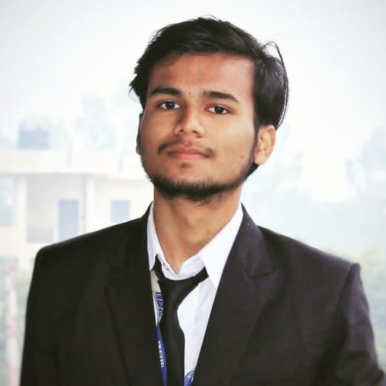



Shivam Kumar Gupta
Analyst/Software Engineer
Bachelor of Technology
Computer Science : 2018 - 2022
Skills
Java 8 /J2EE | Java Basics, OOPS, Generics, Collections, Arrays, Loops, Lambda Exp, Stream API Junit, Mockito
Spring core | IOC & Dependency Injection, Autowire
Spring REST | REST controllers, Implementation of GET, POST, PUT & DELETE, Bean Validation & Exception Handling, Testing Services, Controller & Repository layer
Spring Data JPA | Implement DAO layer using spring Data repositories, Transaction Management
Spring Boot Microservices | Spring Boot Starters, annotations, Messaging Service ,Swagger API documents
Spring Cloud | Eureka, restTemplate , Netflix Hystrix, spring cloud gateway & Config Server
React | Components, Hooks, Event handling,, Testing using Jest, react-routing , react-bootstrap
Database | MongoDB
UI Tech | HTML 5 & CSS 3,JavaScript, ES6 & TypeScript Reusable templates, Optimized UI Designed
Tools | Git, Postman, Maven, IDE
Add On skills | Communications, Team management. Peer learning
Bangalore
xxxxxxxxxxx@capgemini.com
+91 6387345583
A4
Full Stack Developer
Hands on experience in creating microservices with Spring boot, Spring Security, Spring Cloud API Gateway, Eureka server, load balancing, rest Template , email integration
Proficient in creating Single page Web Application in react using react-bootstrap, react forms, react-routing, axios, CSS
Experience in creating documentation with Java docs and swagger and in unit testing using Junit, Mockito including code quality compliance using sonarqube
Development experience in creating docker images and pushing to Docker Hub with containerized applications us
E-Commerce Shopping Cart Application
Completed end to end case study of Shopping Cart Application along with JWT authentication, Swagger and payment gateway using Razor pay, responsive UI with CSS and React used for user interface.
Hotel Management System (2019) Language
Used : C++
Data Structures and Algorithms Self paced Course(GeeksforGeeks) (2020)
Course Completion
Check out my work on GitHub & Video Profile

